Slide 1
Crop analysis and pesticides Recommendation system
Mr. Devdas - Guide

Slide 2
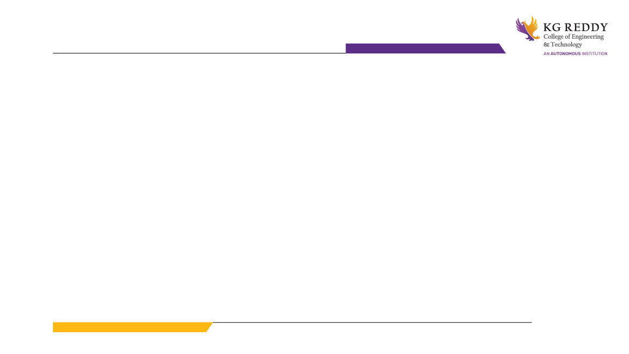
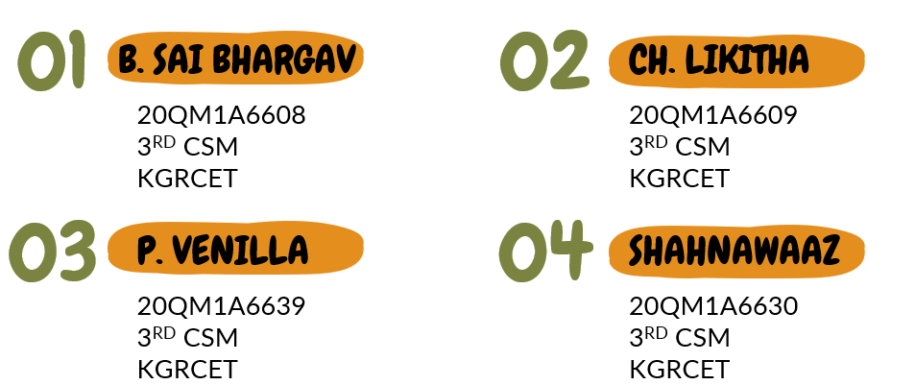
MINI PROJECT GROUP 7

Slide 3
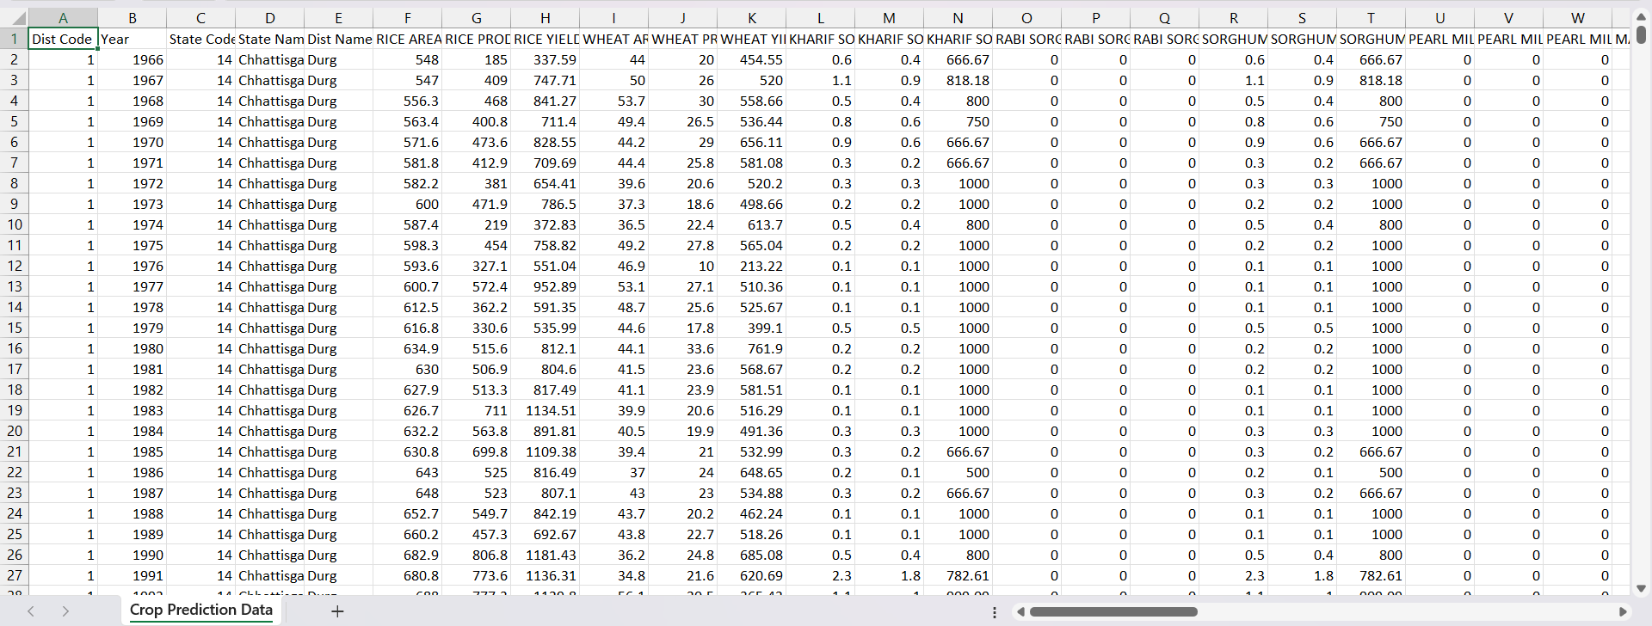
DATASETS :
1) Crop Prediction :
Crop Prediction Data, CSV file format

Slide 4
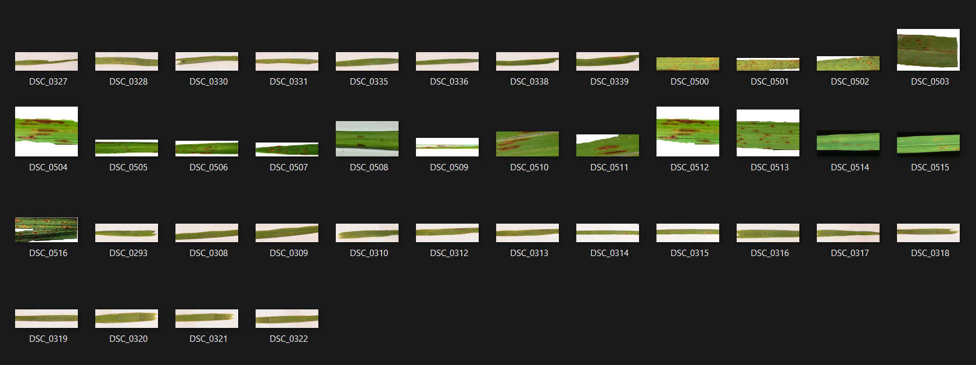
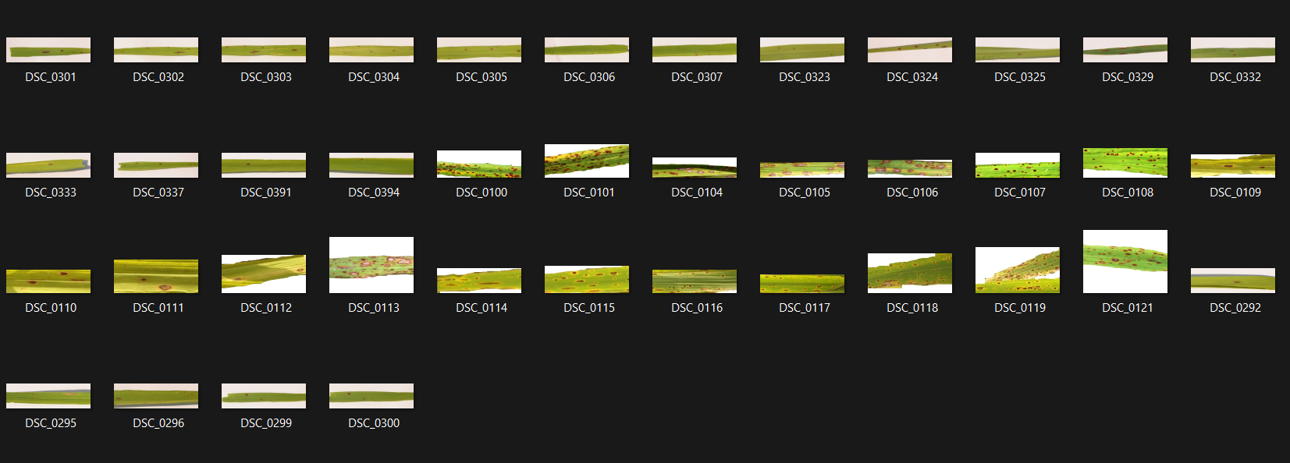
DATASETS :
2) Crop Disease Classification :
Crop Disease Classification Data, CSV file format

Slide 5
DATASETS :
3) Crop Clustering :
In crop clustering, we use data that we have extracted from the crop disease classification.

Slide 6
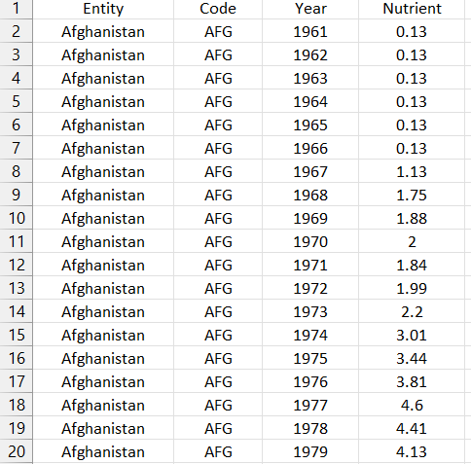
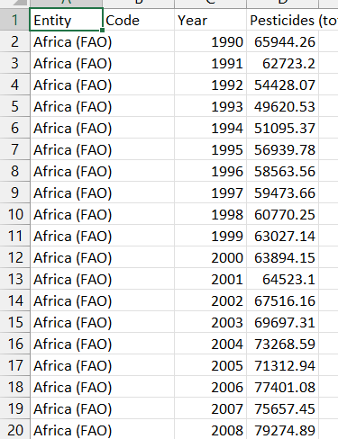
DATASETS :
4) Pesticides and Fertilizers Recommendation:
P&F Data, CSV file format

Slide 7
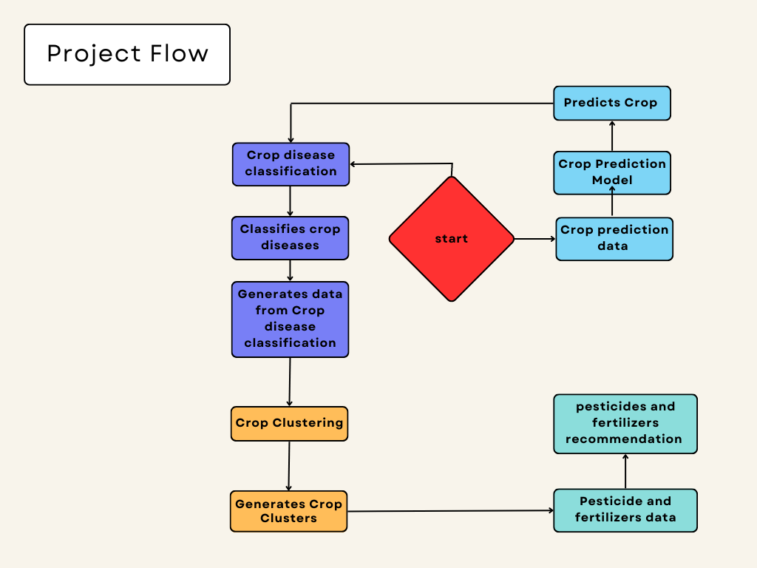

Slide 8
MODULES:
Crop Prediction :
1) Decision Tree
Step-1: Begin the tree with the root node, says S, which contains the complete dataset.
Step-2: Find the best attribute in the dataset using Attribute Selection Measure (ASM).
Step-3: Divide the S into subsets that contains possible values for the best attributes.
Step-4: Generate the decision tree node, which contains the best attribute.
Step-5: Recursively make new decision trees using the subsets of the dataset created in step -3. Continue this process until a stage is reached where you cannot further classify the nodes and called the final node as a leaf node.
Example
1) Suppose there is a candidate who has a job offer and wants to decide whether he should accept the offer or Not.
2) So, to solve this problem, the decision tree starts with the root node (Salary attribute by ASM).
3) The root node splits further into the next decision node (distance from the office) and one leaf node based on the corresponding labels.
4) The next decision node further gets split into one decision node (Cab facility) and one leaf node.
5) Finally, the decision node splits into two leaf nodes (Accepted offers and Declined offer).

Slide 9
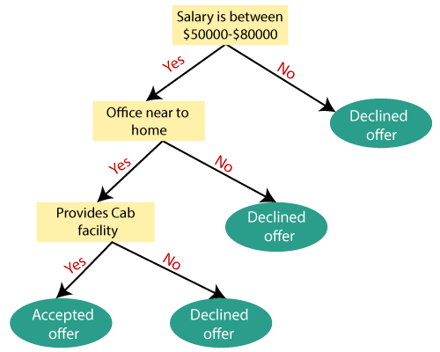

Slide 10
MODULES:
Crop Prediction :
2) Random Forest :
Step-1: Select random K data points from the training set.
Step-2: Build the decision trees associated with the selected data points (Subsets).
Step-3: Choose the number N for decision trees that you want to build.
Step-4: Repeat Step 1 & 2.
Step-5: For new data points, find the predictions of each decision tree, and assign the new data points to the category that wins the majority votes.
Example:
Suppose there is a dataset that contains multiple fruit images.
So, this dataset is given to the Random forest classifier. The dataset is divided into subsets and given to each decision tree.
During the training phase, each decision tree produces a prediction result
when a new data point occurs, then based on the majority of results, the Random Forest classifier predicts the final decision

Slide 11
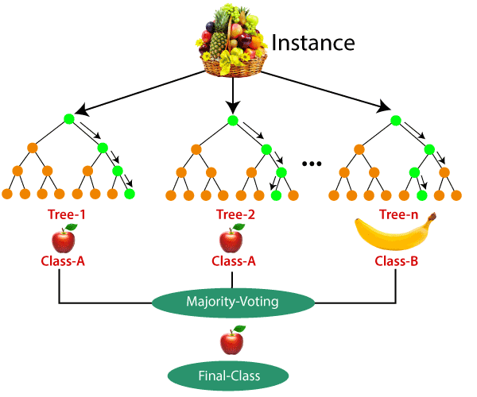

Slide 12

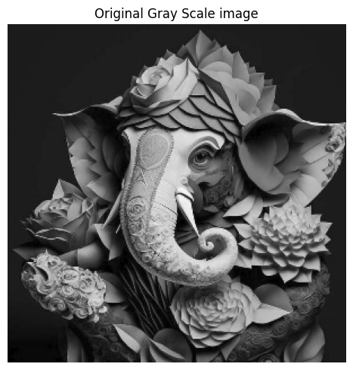
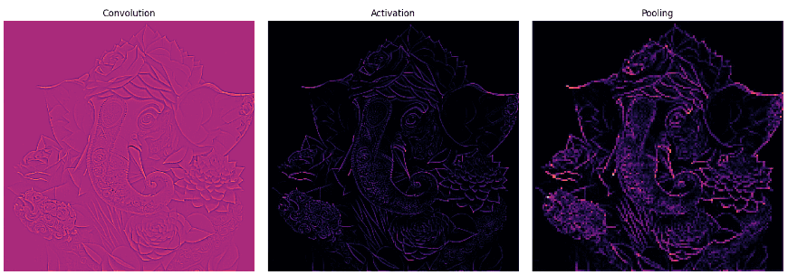
MODULES:
2) Crop disease classification :
Example:
Conventional Neural Networks:
import the necessary libraries
set the parameter
define the kernel
Load the image and plot it.
Reformat the image
Apply convolution layer operation and plot the output image.
Apply activation layer operation and plot the output image.
Apply pooling layer operation and plot the output image.

Slide 13
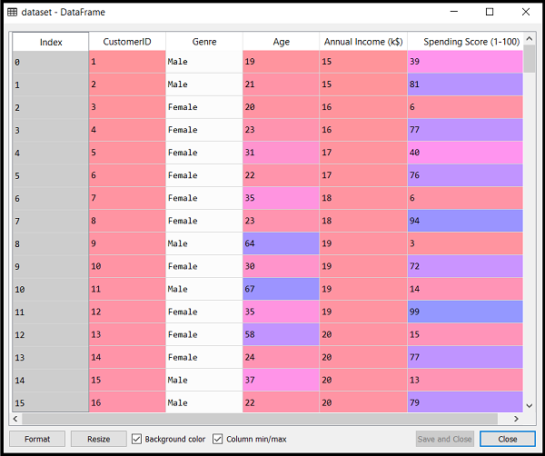
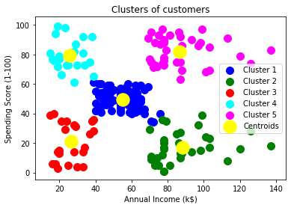
MODULES:
Example:
3) Crop Clustering:
1)K-Means Clustering :
Step-1: Select the number K to decide the number of clusters.
Step-2: Select random K points or centroids. (It can be other from the input dataset).
Step-3: Assign each data point to their closest centroid, which will form the predefined K clusters.
Step-4: Calculate the variance and place a new centroid of each cluster.
Step-5: Repeat the third steps, which means reassign each datapoint to the new closest centroid of each cluster.
Step-6: If any reassignment occurs, then go to step-4 else go to FINISH.
Step-7: The model is ready.

Slide 14
MODULES:
Example:
Cluster (1, 3) (2, 5) (4, 8) (7, 9)
1) 0.8 0.7 0.2 0.1
0.2 0.3 0.8 0.9
Cluster Centers:
[[0.42363557 0.68304616]
[0.52768166 0.38180987]
[0.39967863 0.31042639]]
Cluster Membership:
[1 0 1 2 1 0 0 2 0 2 1 0 0 0 1 2 1 1 0 2 1 0 0 2 1 1 2 0 1 0 0 2 0 2 1 1 0
1 0 2 0 0 2 0 0 1 1 1 1 2 2 0 1 1 0 1 0 0 2 2 2 0 1 1 2 0 0 0 2 1 0 1 0 0
1 2 0 0 2 2 1 1 0 2 1 0 2 2 1 1 0 2 1 0 2 1 0 2 2 2 0 1 0 2]
3) Crop Clustering:
2) Fuzzy Clustering :
Step 1: Initialize the data points into the desired number of clusters randomly.
Step 2: Find out the centroid.
Step 3: Find out the distance of each point from the centroid.
Step 4: Updating membership values.
Step 5: Repeat the steps(2-4) until the constant values are obtained for the membership values or the difference is less than the tolerance value
Step 6: Defuzzify the obtained membership values.

Slide 15
MODULES:
4) Pesticide and Fertilizer recommendation
1) Collabarative Based filtering:
Step 1: Finding the similarity of users to the target user U.
Step 2: Prediction of missing rating of an item
Example: Consider a matrix that shows four users Alice, U1, U2 and U3 rating on different news apps. The rating range is from 1 to 5 on the basis of users’ likability of the news app.
Step 1: Calculating the similarity between Alice and all the other users At first we calculate the averages of the ratings of all the user excluding I5 as it is not rated by Alice.
Step 2:Predicting the rating of the app not rated by Alice Now, we predict Alice’s rating for BBC News App.

Slide 16
Example :
Name Inshorts(I1) HT(I2) NYT(I3) TOI(I4) BBC(I5)
Alice 5 4 1 4 ?
U1 3 1 2 3 3
U2 4 3 4 3 5
U3 3 3 1 5 4
Step 1:
Step 2:
[Tex]r_{(Alice,I5)}=3.5 + \frac {(0.301*0.75)+(-0.33*1.5)+(0.707*1)}{|0.301|+|-0.33|+|0.707|}=3.83\newline
Name Inshorts(I1) HT(I2) NYT(I3) TOI(I4)
Alice 1.5 0.5 -2.5 0.5
U1 0.75 -1.25 -0.25 0.75
U2 0.5 -0.5 0.5 -0.5
U3 0 0 -2 2

Slide 17
MODULES:
4) Pesticide and Fertilizer recommendation
2) Content Based filtering:
Content-based filtering makes recommendations by using keywords and attributes assigned to objects in a database (e.g., items in an online marketplace) and matching them to a user profile. The user profile is created based on data derived from a user’s actions, such as purchases, ratings (likes and dislikes), downloads, items searched for on a website and/or placed in a cart, and clicks on product links.
Example: suppose you’re recommending accessories to a user that just purchased a smartphone from your website and has previously bought smartphone accessories. Aside from keywords such as the smartphone manufacturer, make, and model, the user profile indicates prior purchases include phone holders with sleeves for credit cards. Based on this information, the recommender system may suggest similar phone holders for the new phone with attributes such as an RFID blocking fabric layer to help prevent unauthorized credit card scanning. In this example, the user would expect recommendations for similar phone holders, but the RFID blocking feature may be something they didn’t expect yet appreciate.

Slide 18


